Slide 1
Population-based metaheuristics
Nature-inspired
Initialize a population
A new population of solutions is generated
Integrate the new population into the current one using one these methods – by replacement which is a selection process from the new and current solutions
Evolutionary Algorithms – genetic algorithm
Estimation of distribution algorithm (EDA)
Scatter search
Evolutionary programming- genetic programming
Swarm Intelligence
Ant colony
Particle swarm optimization (PSO)
Bee colony
Artificial Immune system AIS
Continue until a stopping criteria is reached
The generation and replacement process could be memoryless or some search memory is used

Slide 2
More on search memory, generation and selection
Search memory
In most cases the population of solutions is the search memory – GA, scatter search, PSO- population of particles, bee colony- population of bees, AIS- population of antibodies
For ant colony – Pheromone matrix – shared memory is updated
EDA – probabilistic learning model – shared memory is updated
Generation
Evolution based – reproduction via variation operators (mutation, crossover, merge) that act direct on the their representations (parents)
EA (binary operator- crossover) and scatter search (n-array operator, n>2)
Blackboard based – solutions create a shared memory which generates new solutions, which is an indirect method
Any colony – the generated solutions via the past ants will affect the generated solutions of the future ants via the pheromone.
EDA- probabilistic learning model is updated

Slide 3
More on search memory, generation and selection
Selection
New solutions are selected from the union of the current and generated populations
elitism - if the best of both current and new is selected
Sometimes the newly generated population is considered as the new solutions
In blackboard the is no explicit selection. The new population will affect the shared memory

Slide 4
Initial Population
By construction P- metaheuristics is more of exploration (diversification) than S-metaheuristics, which is more exploitation (intensification)
In P-metaheuristics insufficient diversification can result in premature convergence particularly if the initial population is chosen using a greedy heuristic or S-metaheuristic (tabu search, SA etc.) for each solution of the population.
Methods for initial population generation
Random generation use classical random number generators
Sequential diversification- simple sequential inhibition process (SSI). Any new solution that is added to the initial subpopulation must be a certain distance δ away from the other solutions in that subpopulation
Parallel diversification – uniform sampling using a Latin hypercube.

Slide 5
Stopping criteria
Fixed number of iterations
Limit on CPU time
Fixed number of iterations with no improvement in the obj function
A satisfactory obj function value is reached

Slide 6
Common concepts of Evolutionary Alg
Main search components are
Representation - For Ex: in Genetic Algorithm GA, the encoded solution is called a chromosome. The decision variables within a solution are genes. The possible values of the genes are allele and the position of the element (gene) within a chromosome is named locus.
Ex TSP Chromosome = (_,_,_,_,_,_,_,_,_)
Population Initialization
Objective function, also called fitness in EA terminology.
Selection strategy – which parents are chosen for the next generation with the objective of better fitness
Reproduction strategy – mutation, crossover, merge, or from a shared memory
Replacement strategy – using the best of the old and new population – survival of the fittest
Stopping criteria

Slide 7
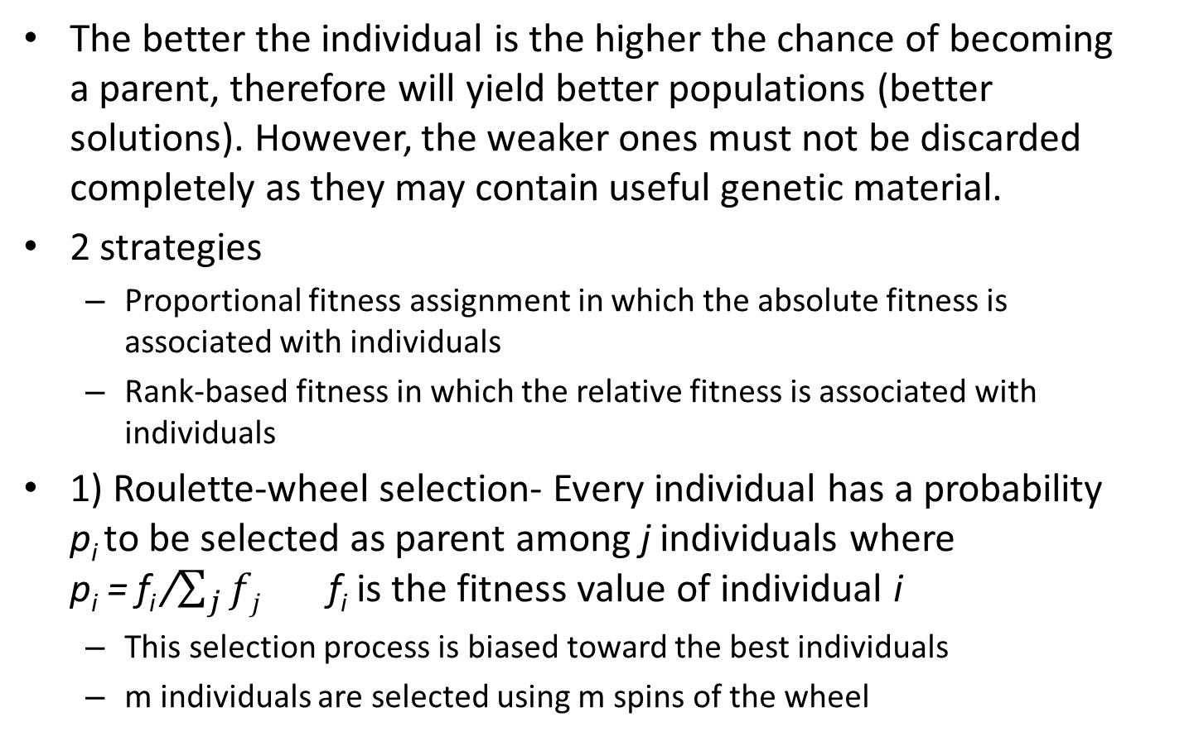
Selection
The better the individual is the higher the chance of becoming a parent, therefore will yield better populations (better solutions). However, the weaker ones must not be discarded completely as they may contain useful genetic material.
2 strategies
Proportional fitness assignment in which the absolute fitness is associated with individuals
Rank-based fitness in which the relative fitness is associated with individuals
1) Roulette-wheel selection- Every individual has a probability p_{i} to be selected as parent among j individuals where p_{i} = f_{i} /$\sum_{j}{fj}$ f_{i} is the fitness value of individual i
This selection process is biased toward the best individuals
m individuals are selected using m spins of the wheel

Slide 8
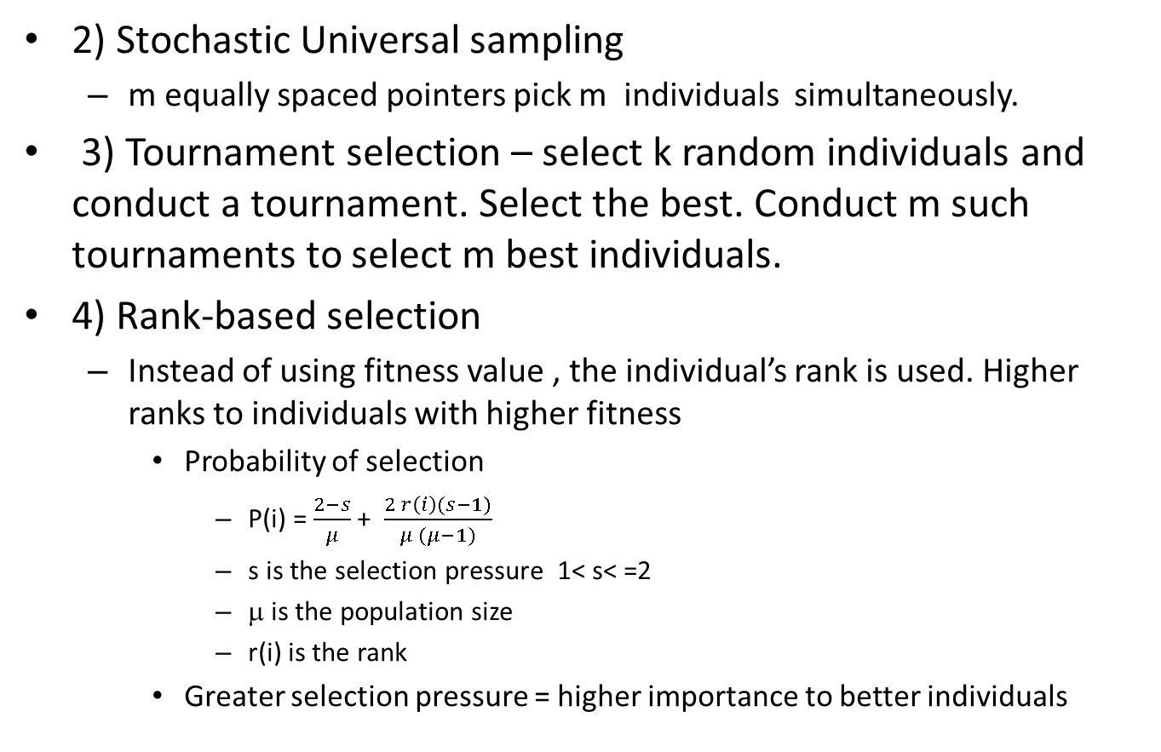
Selection
2) Stochastic Universal sampling
m equally spaced pointers pick m individuals simultaneously.
3) Tournament selection – select k random individuals and conduct a tournament. Select the best. Conduct m such tournaments to select m best individuals.
4) Rank-based selection
Instead of using fitness value , the individual’s rank is used. Higher ranks to individuals with higher fitness
Probability of selection
P(i) = $\frac{2−s}{μ}$ + $\frac{2 r\left(i\right)(s−1)}{μ (μ−1)}$
s is the selection pressure 1< s< =2
μ is the population size
r(i) is the rank
Greater selection pressure = higher importance to better individuals

Slide 9
Reproduction
Mutation
The operators act on a single individual
Changes are small
Ergodicity- mutations must allow every solution to be reached
Validity – the solutions must be feasible – often difficult to maintain in constrained optimization.
Locality – the changes in the phenotype by mutating the genotype must be small which ensures strong locality.
Highly disruptive mutations are not desired.
Mutation in binary representation – flip operator
In discrete representation – change the value of an associated element to another
In permutations – swapping, inversion, insertion operators.

Slide 10
Reproduction
Crossover
Heritability – the cross over must inherit a genetic material from both parents.
Validity – the solutions must be feasible – often difficult to maintain in constrained optimization.
1 point crossover Parents ABCDEF, abcdef , offsprings ABCDef , abcdEF
2-point crossover Parents ABCDEF, abcdef offsprings ABcdEF abCDef
Intermediate crossover, one offspring is produced by weighted averaging the elements of the parents
Geometric crossover (element n of parent 1 X element n of parent 2)^{1/2} for all n elements
Uniform crossover parents 111111 000000 offsprings 101001 010110

Slide 11
Crossover
Order crossover
A B C D E F G H I h d a e i c f b g
offspring a i C D E F b g h
Preserve the sequence from parent 1 and fill in the missing elements from parent 2 by starting from the first crossover point
Two point crossover in permutation
Retain elements outside the crossover from parent 1 and fill in the rest from parent 2
1 2 3 4 5 6 7 8 6 2 5 8 7 1 3 4
Offspring 1 2 6 5 7 3 4 8

Slide 12
Replacement
Generational replacement – the offsprings will systematically replace the parents.
Steady-state replacement- only one offspring is selected and the worst parent is replaced.
General rules
Population size is usually from 20-100
Crossover probability (rate) is the proportion of parents on which a cross over operator will act to produce offsprings. It is usually between 45-95%
Use a cross over procedure
Mutation is done only to one variable in an iteration

Slide 13
Genetic Algorithm
Very popular method from the 1970s. Used in optimization and machine learning.
Representation – binary or non-binary (real-valued vectors)
Use a crossover rate to choose parents that will generate offsprings.
Applies n-point or uniform crossover to two parent solutions and a mutation (bit flipping) to randomly modify the individual solutions contents to promote diversity.
Selection is based on proportional fitness assignment
Replacement is generational – parents are replaced by the offsprings.
See handout for an example.

Slide 14
Scatter Search
Combines both P and S metaheuristics
Select an initial population satisfying both diversity and quality – reference set
Use both recombination – cross over, mutation followed by S-meta heuristics (local search) to create new populations
Evaluate the objective function
This ensures diversity and quality
Update the reference set with the best solutions
Continue the process till stopping criteria.

Slide 15
Estimation of Distribution Algorithm
Generate a population of solutions
Evaluate the objective function of the individuals
Select m best individuals using any selection method
Use the m sample population to generate a probability distribution
New individuals are generated by sampling this distribution to form the next new population
Also called non-Darwinian evolutionary algorithm
Continue until stopping criteria is reached

Slide 16
Estimation of Distribution Algorithm
0 0 1 0 1 0 1
1 1 0 0 0 0 0
1 0 0 0 1 1 1
1 0 0 0 1 1 0
0 1 0 0 1 1 0
Probability distribution for the 1’s is P and 0’s is 1-P
P = 0.6 0.4 0.2 0 0.8 0.6 0.4
Use U [0,1] to generate new members for each individual in the population.
Does not use mutation or crossover

